Slide 1
Contemporary Issues in Leadership

Slide 2
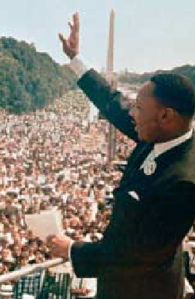
Framing: Using Words to Shape Meaning and Inspire Others
Leaders use framing (selectively including or excluding facts) to influence how others see and interpret reality.

Slide 3
Inspirational Approaches to Leadership
Looking at leaders who inspire followers through their words, ideas and behaviour
Charismatic Leadership Theory
charisma: (Greek) gift
Robert House: first researcher to consider charismatic leadership in terms of OB
Followers make attributions of heroic or extraordinary leadership abilities when they observe certain behaviors.
A number of studies have tried to identify the characteristics of the charismatic leader

Slide 4
Key Characteristics of Charismatic Leaders
Vision and articulation. Has a vision—expressed as an idealized goal—that proposes a future better than the status quo; and is able to clarify the importance of the vision in terms that are understandable to others.
Personal risk. Willing to take on high personal risk, incur high costs and engage in self-sacrifice to achieve the vision.
Sensitivity to follower needs. Perceptive of others’ abilities and responsive to their needs and feelings.
Unconventional behavior. Engages in behaviors that are perceived as novel and counter to norms.

Slide 5
Are charismatic leaders born or made?
It is true that individuals are born with traits that make them charismatic...but it is possible to change
firstly
  develop an aura of charisma by maintaining an optimistic view
  be passionate as a catalyst to generate enthusiasm
  communicate with the whole body, not just words
secondly
  create a bond that inspires others to follow
thirdly
  bring out the potential in followers by tapping into their emotions

Slide 6
DOWN SIDE OF CHARISMATIC LEADERSHIP
Ego-centric and self centered individuals can use organisations for their own gains
Because of their power to captivate others, charismatic leaders can be dangerous as they can convince their followers towards a vision which leads to disaster

Slide 7
Transactional and Transformational Leadership
Transactional Leaders
Approach follower with an eye to exchange one thing for another.
Pursues a cost-benefit, economic exchange with followers, in return for services rendered by them
Transformational Leaders
Leaders who inspire individuals to go beyond self interest for organisational good and have extraordinary effect on their followers.

Slide 8
Contrasting transactional versus transformational leadership
Transactional
Transformational
Aware of link between effort and reward
Leadership is responsive and deals with present issues
Motivate by setting goals and promising rewards for desired performance
Rely on standard forms of inducement – reward, punishment, control
Arouse emotions in their followers which motivate followers to work for goals that go beyond self-interest.
Proactive and forms new expectations in followers
Create learning opportunities for followers and stimulate followers to solve problems
Has capacity to inspire and provide individualized consideration, intellectual stimulation and idealized influence to their followers

Slide 9
Authentic Leadership
Ethics and Trust
Why now…
Many past leaders suffered from ethical shortcomings (enron, worldcom, arthur anderson, merril lynch, Satyam)‏
Unethical leaders are more likely to use their charisma to enhance their power over followers, directed to self-serving ends.
Abuse of power
Top executives set the moral tone of the organisation

Slide 10
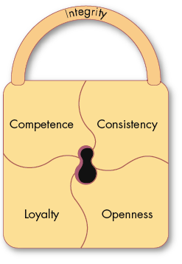
Trust: The Foundation of Leadership
Trust
A positive expectation that another will not—through words, actions, or decisions—act opportunistically.
Trust is a history-dependent process (familiarity) based on relevant but limited samples of experience (risk).

Slide 11

Dimensions of Trust
Integrity
  honesty and truthfulness.
Competence
  an individual’s technical and interpersonal knowledge and skills.
Consistency
  an individual’s reliability, predictability, and good judgment in handling situations.
Loyalty
  the willingness to protect and save face for another person.
Openness
  reliance on the person to give you the full truth.
If people are going to follow someone willingly, they need assurances that the person is worthy of their trust.

Slide 12

Three Types of Trust in organisational relationships
Deterrence-based Trust
Trust based on fear of reprisal if the trust is violated.
Knowledge-based Trust
Trust based on behavioral predictability that comes from a history of interaction.
Identification-based Trust
Trust based on a mutual understanding of each other’s intentions and appreciation of the other’s wants and desires.

